Slide 1
Neuropathic Pain – Beyond Gabapentinoids and Duloxetine?
Narayan R. Kissoon, MD
Assistant Professor of Neurology and Anesthesiology
Division of Headache, Dept. of Neurology
Division of Pain Medicine, Dept. of Anesthesiology and Perioperative Medicine
Mayo Clinic, College of Medicine

Slide 2
DISCLOSURE OF RELEVANT FINANCIAL RELATIONSHIP(S) WITH INDUSTRY
SAB of Bright Minds Biosciences, Ltd
Investigator Initiated Study (IIS) grant with Nevro Corporation, but for an unrelated topic (Diabetic Peripheral Neuropathy)
Royalties from UpToDate
REFERENCES TO OFF-LABEL USAGE(S) OF PHARMACEUTICALS OR INSTRUMENTS
Use of most medications used for neuropathic pain are considered off-label use. Off label use of CGRP monoclonal antibodies and Neuromodulation will be discussed

Slide 3
Narayan R. Kissoon, MD Assistant Professor of Neurology and Anesthesiology Division of Headache, Dept. of Neurology Division of Pain Medicine, Dept. of Anesthesiology and Perioperative Medicine Mayo Clinic, College of Medicine E-mail: kissoon.narayan@mayo.edu

Slide 4
LEARNING OBJECTIVES
Review dosing regimens of first line agents to treat neuropathic pain
Discuss medication options to treat neuropathic pain when first line agents fail
Explore non oral medication strategies to treat neuropathic pain
Notes:
Access/Routine use

Slide 5
Medications for Neuropathic Pain Use characteristics of pain and comorbidities to determine medication
Gabapentin – (can titrate as high as 900-1200mg four times daily)
Pregabalin – consider 6:1 conversion from gabapentin (eg, 600 TID of gabapentin = 100 TID of pregabalin) with max daily dose of 600mg
TCA – amitriptyline/nortriptyline (50mg to 100mg) dosed 2 hours before bedtime.
Effective for burning type pain
No higher than 50mg if on concurrent SSRI/SNRI
Avoid use with bupropion and known epilepsy history (lowers seizure threshold)
If sedating or weight gain, then consider protriptyline (10mg twice daily during day with evening dose at 3-4 pm because stimulating)
ECG for patients over age of 50, known CAD, or concurrent SSRI use
Carbamazepine or Oxcarbazepine: risk for hyponatremia, and needs periodic lab monitoring
Lamotrigine (slow titration to avoid Stevens-Johnson Syndrome)
Lacosamide – ECG before and after titration
List is not comprehensive, but rather highest yield

Slide 6
Amitriptyline/Nortriptyline
Take 2 hours before bedtime
Side effects: dry mouth, constipation, weight gain, sedation
Consider ECG prior and after reaching goal dose if over age 50, known CAD, or on SSRI
Avoid use with bupropion and known epilepsy history (lowers seizure threshold)
Some SSRIs may be ok to use concurrently (duloxetine, sertraline), but need to keep doses low (max 50 mg) and review drug interactions (e.g. QT prolongation)
 | Tablet Size (mg) | Time of Dose (Evening) | Total Daily Dose (mg)
Week 1 | 10 | 1 | 10
Week 2 | 10 | 2 | 20
Week 3 | 10 | 3 | 30
Week 4 | 10 | 4 | 40
Week 5 | 10 | 5 | 50
Ongoing | 50 | 1 | 50

Slide 7
Gabapentin
Gabapentin dosing
Alpha 2 Delta ligand
Modulates calcium release via voltage gated calcium channels
Similar structure to GABA neurotransmitter, but does not bind to GABA receptor or modulate synthesis or uptake of GABA
Side effects: weight gain, sedation, leg swelling
Extended-release formulations available
Roughly 6:1 conversion from gabapentin to pregabalin
 | Capsule or tablet size | Time of dose |  |  | Total daily dose
 |  | Morning | Noon | Evening
Week 1 | 300mg | 0 | 0 | 1 | 300mg
Week 2 | 300mg | 1 | 0 | 1 | 600mg
Week 3 | 300mg | 1 | 1 | 1 | 900mg
Week 4 | 300mg | 1 | 1 | 2 | 1200mg
Week 5 | 300mg | 2 | 1 | 2 | 1500mg
Week 6 | 300mg | 2 | 2 | 2 | 1800mg
Ongoing | 600mg* | 1 | 1 | 1 | 1800mg

Slide 8
Carbamazepine
Carbamazepine dosing
Sodium channel blocker
Carbamazepine – max dose 1200mg per day in divided doses
Consider extended-release formulation for more stable drug levels
Side effects: rash, dizziness, ataxia sedation, blurred vision, tinnitus
Risk for hyponatremia and agranulocytosis/anemia and
Needs periodic lab monitoring with CBC, sodium, Cr, LFTs
 | Capsule or tablet size | Time of dose |  |  | Total daily dose
 |  | Morning | Noon | Evening
Week 1 | 200mg | 0 | 0 | 1 | 200mg
Week 2 | 200mg | 1 | 0 | 1 | 400mg
Week 3 | 200mg | 1 | 1 | 1 | 600mg
Week 4 | 200mg | 1 | 1 | 2 | 800mg
Week 5 | 200mg | 2 | 1 | 2 | 1000mg
Week 6 | 200mg | 2 | 2 | 2 | 1200mg
Ongoing | 400mg* | 1 | 1 | 1 | 1200mg
In patients with Asian descent, carriers of HLA-B*15:02 run risk of Stevens-Johnson syndrome

Slide 9
Lamotrigine
Slow titration up to 100mg twice daily to avoid Stevens-Johnson Syndrome
Sodium channel blocker
Side effects: rash, GI upset, dizziness, sedation, blurred vision
Review drug interactions prior to starting
Levels increased by certain medications or supplements (eg, valproic acid, ginseng)
Levels lowered by some mediations (eg, oral contraceptives, phenytoin, carbamazepine)
 | Tablet size | Time of dose |  | Total daily dose
 |  | Morning | Evening
Week 1 | 25mg | 0 | 1 | 25mg
Week 2 | 25mg | 0 | 1 | 25mg
Week 3 | 25mg | 1 | 1 | 50mg
Week 4 | 25mg | 1 | 1 | 50mg
Week 5 | 25mg | 2 | 2 | 100mg
Week 6 | 25mg | 3 | 3 | 150mg
Ongoing | 100mg* | 1 | 1 | 200mg

Slide 10
Lacosamide
Twice daily dosing with initial dose of 100 mg twice daily, but could increase further in same manner up to 200mg twice daily
Sodium channel blocker
Possible side effects include double vision, headache, dizziness, and nausea
ECG prior to and after titration (PR prolongation or other arrhythmias)
 | Capsule or tablet size | Time of dose |  | Total daily dose
 |  | Morning | Evening
Week 1 | 50mg | 0 | 1 | 50mg
Week 2 | 50mg | 1 | 1 | 100mg
Week 3 | 50mg | 1 | 2 | 150mg
Ongoing | 100mg* | 1 | 1 | 200mg

Slide 11
Interventions and Non-Oral Medication options for Neuropathic Pain
Topical Creams
Spinal Cord Stimulation
Scrambler Therapy
DRG Stimulation
CGRP monoclonal antibodies

Slide 12
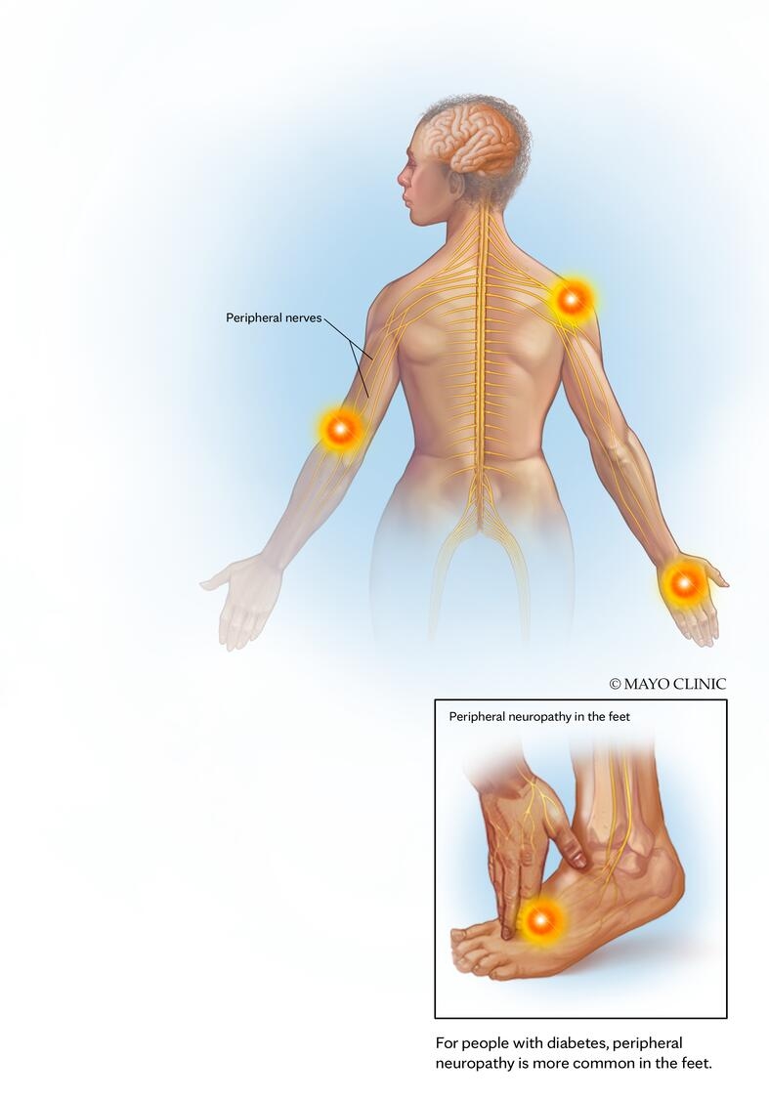
Topical Treatments
Lidocaine patch 4% available over the counter (5% is prescription strength) – 12 hours on and 12 hours off
Diclofenac 1% gel – over the counter
Prescription Compounded creams (e.g. lidocaine 5%, ketamine 5%, amitriptyline 2%)
1 gm (e.g. quarter sized amount) applied 2 times a day as needed
PLO gel or Vanicream often used for base. PLO for focal areas and Vanicream better for more diffuse areas.

Slide 13
90-year-old Male with bilateral lower extremity neuropathic pain
10 years prior developed type 2 diabetes mellitus – HgA1c = 7.3%
3 years prior developed sharp pain with prominent allodynia involving the soles of his feet bilaterally
Exam showed distal lower extremity weakness with length dependent sensory changes
EMG showed sensorimotor length dependent peripheral neuropathy
Baseline 3-4/10 pain, but with any walking his pain is a 7/10 in severity
Gabapentin 300mg in the morning and 200mg at night. High doses have been limited due to dizziness
He denies any upper extremity symptoms

Slide 14
Spinal Cord Stimulation
Mean EQ-5D-5L VAS overall and index scores
Index score
Overall health VAS score
100
1.0
10-kHz SCS plus CMM
80
0.8
60
0.6
EQ-5D-5L health VAS
EQ-5D-5L index
CMM
40
0.4
20
0.2
0
0
Baseline
6 mo
Baseline
6 mo
Baseline
3 mo
6 mo
CMM
10-kHz SCS plus CMM
Recently FDA approved specifically for Painful Diabetic Neuropathy (overarching labeling is for intractable neuropathic pain of the trunk and/or limbs)

Slide 15
Spinal Cord Stimulation
Proportion of participants with ≥50% pain relief or lower limb pain VAS score ≤3cm
Mean lower limb pain VAS scores over time
100
10
CMM
10-kHz SCS plus CMM
80
8
CMM
60
6
Participants, %
Lower limb pain VAS, cm
40
4
20
10-kHz SCS plus CMM
2
0
VAS ≤3cm
VAS ≤3cm
≥50% relief
VAS ≤3cm
≥50% relief
≥50% relief
0
Baseline
3 mo
6 mo
1 mo
3 mo
6 mo

Slide 16
90-year-old Male with bilateral lower extremity neuropathic pain
Sustained pain relief at 12 months
Essentially pain free 0/10 with rare episodes of pain
No longer has cutaneous allodynia
Gabapentin dose reduced to 300mg per day

Slide 17
Scrambler Therapy
Treatment 30 minutes a day for 10 days
Electrodes placed proximal and adjacent to areas of pain
Most studied in Chemotherapy induced peripheral neuropathy
Comparative efficacy study showed improved outcomes for scrambler therapy during the treatment period when compared to TENS
Majority of patients would recommend therapy to others
No difference between groups at 8-week f/u in small pilot study (n=50)

Slide 18
Scrambler Therapy
Global impression of change in pain ratings
Very much better
Scrambler
TENS
Moderately better
A little better
Global impression of change rating (mean)
About the same
A little worse
Moderately worse
Very much worse
0
1
2
3
4
5
6
7
8
9
10
11
12
13
14
3
4
5
6
7
8
9
10
Days
Weeks
Patient numbers
24 24 24 24 24 21 21 24 24 24 24 23 20 20 24 22 21 22 21 20 22 22
22 21 22 21 22 21 21 19 21 22 22 20 21 21 20 19 18 18 18 17 16 17

Slide 19
Scrambler Therapy
Yes, to therapy recommendation
100
Scrambler
TENS
80
60
Yes, to therapy recommendation (%)
40
20
0
0
1
2
3
4
5
6
7
8
9
10
11
12
13
14
3
4
5
6
7
8
9
10
Days
Weeks
Patient numbers
24 24 24 23 24 21 21 24 24 24 24 23 19 19 24 22 22 23 21 20 22 21
21 21 21 19 22 22 21 19 21 21 22 20 21 21 19 19 18 18 18 17 15 17

Slide 20
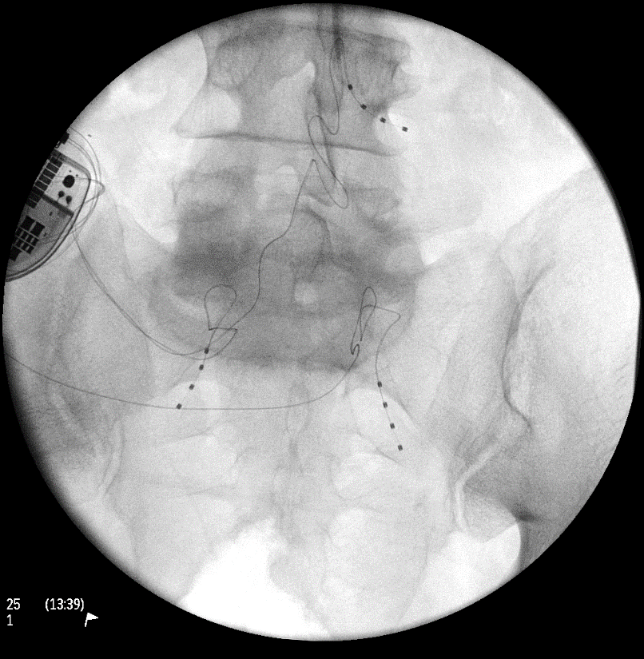
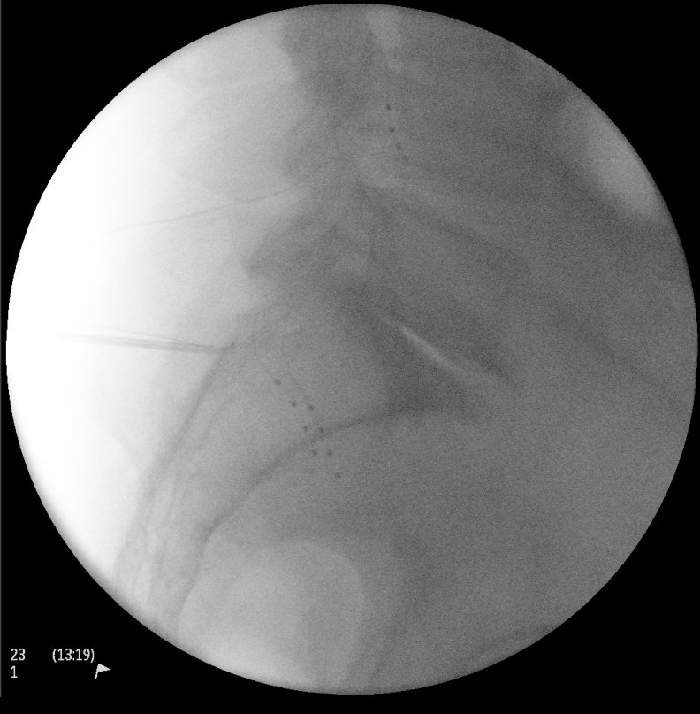
DRG Stimulation
FDA approved for treatment of lower extremity CRPS
Comparative efficacy study (N=152) vs SCS should improved outcomes (50% responder rate)
When compared to SCS generally better response for distal extremity neuropathic pain (eg, foot), but challenging to place leads and issues with lead migration/fracture
Other conditions treated with DRG stimulation
Chronic pain in trunk, limbs and sacral region
Post-herpetic neuralgia
Phantom limb pain
Chronic neuropathic post-surgical pain
Chronic post surgical inguinal pain
Upper extremity and trunk neuropathic pain
Painful peripheral neuropathy

Slide 21
CGRP MonoClonal Antibodies
FDA approved for both episodic and chronic migraine, consider in patients with comorbid migraine (20% of the population), off-label use in neuropathic pain
4 commercially available:
galcanezumab, erenumab, and fremanezumab
Monthly or quarterly injections
40% of patients had a 50% reduction in headache
In single case series, >30% reduction after 12 months of treatment of neuropathic pain associated with painful peripheral neuropathy in patients with co-morbid migraine
No known contraindications or black box warnings
Side effects: URI symptoms, constipation, fatigue
Avoid in secondary Raynaud’s Phenomena
Typically, prior trials ≥2 oral preventive medications required prior to start of medication
100
Pt 1
Pt 2
Pt 3
Pt 4
Pt 5
Pt 6
Pt 7
Pt 8
Pt 9
Pt 10
Pt 11
Pt 12
Pt 13
Pt 14
Average
90
80
70
60
Score on neuropathy pain scale (NPS)
50
40
30
20
10
0
3 mo prior
Baseline
3 mo post
6 mo post
9 mo post
12 mo post
Administration of anti-CGRP monoclonal antibodies
Patients reported 41.7% reduction in NPS scores following 12 months of treatment

Slide 22
Summary
Use characteristics of pain and comorbidities to determine neuropathic medication selection
Topicals may a nice adjunctive treatment, but likely not the sole treatment option
Scrambler therapy is well tolerated and liked by patients, but availability is challenging along with insurance coverage
In patients with comorbid migraine, they neuropathic pain may respond to CGRP monoclonal antibody treatment for their migraine
Patients may be candidates for neuromodulation (SCS, DRG)

Slide 23
References
Goadsby PJ, Reuter U, Hallstrom Y, et al. A Controlled Trial of Erenumab for Episodic Migraine. N Engl J Med 2017;377:2123-2132.
Silberstein SD, Dodick DW, Bigal ME, et al. Fremanezumab for the Preventive Treatment of Chronic Migraine. N Engl J Med 2017;377:2113-2122.
Stauffer VL, Dodick DW, Zhang Q, Carter JN, Ailani J, Conley RR. Evaluation of Galcanezumab for the Prevention of Episodic Migraine: The EVOLVE-1 Randomized Clinical Trial. JAMA Neurol 2018;75:1080-1088.
Lipton et al. Efficacy and safety of eptinezumab in patients with chronic migraine. Neurology 2020;94:e1365-e1377.
Kang SA, Govindarajan R. Anti-calcitonin gene-related peptide monoclonal antibodies for neuropathic pain in patients with migraine headache. Muscle Nerve 2020 doi: 10.1002/mus.27153 [published Online First: 2020/12/22]
Deer TR, Levy RM, Kramer J, et al. Dorsal root ganglion stimulation yielded higher treatment success rate for complex regional pain syndrome and causalgia at 3 and 12 months: a randomized comparative trial. Pain 2017;158:669-681
Piedade GS, Vesper J, Chatzikalfas A, Slotty PJ. Cervical and High-Thoracic Dorsal Root Ganglion Stimulation in Chronic Neuropathic Pain. Neuromodulation 2019.
Eldabe S, Burger K, Moser H, et al. Dorsal Root Ganglion (DRG) Stimulation in the Treatment of Phantom Limb Pain (PLP). Neuromodulation 2015;18:610-616; discussion 616-617.
Liem L, Mekhail N. Management of Postherniorrhaphy Chronic Neuropathic Groin Pain: A Role for Dorsal Root Ganglion Stimulation. Pain Pract 2016;16:915-923.
Liem L, Russo M, Huygen FJ, et al. A multicenter, prospective trial to assess the safety and performance of the spinal modulation dorsal root ganglion neurostimulator system in the treatment of chronic pain. Neuromodulation 2013;16:471-482; discussion 482.
Wilson RD, Gunzler DD, Bennett ME, Chae J. Peripheral nerve stimulation compared with usual care for pain relief of hemiplegic shoulder pain: a randomized controlled trial. Am J Phys Med Rehabil 2014;93:17-28.
Wilson RD, Harris MA, Gunzler DD, Bennett ME, Chae J. Percutaneous peripheral nerve stimulation for chronic pain in subacromial impingement syndrome: a case series. Neuromodulation 2014;17:771-776; discussion 776.
Yu DT, Chae J, Walker ME, et al. Intramuscular neuromuscular electric stimulation for poststroke shoulder pain: a multicenter randomized clinical trial. Arch Phys Med Rehabil 2004;85:695-704.
Gilmore C, Ilfeld B, Rosenow J, et al. Percutaneous peripheral nerve stimulation for the treatment of chronic neuropathic postamputation pain: a multicenter, randomized, placebo-controlled trial. Reg Anesth Pain Med 2019;44:637-645.
Gilmore CA, Kapural L, McGee MJ, Boggs JW. Percutaneous Peripheral Nerve Stimulation (PNS) for the Treatment of Chronic Low Back Pain Provides Sustained Relief. Neuromodulation 2019;22:615-620.
Deer T, Pope J, Benyamin R, et al. Prospective, Multicenter, Randomized, Double-Blinded, Partial Crossover Study to Assess the Safety and Efficacy of the Novel Neuromodulation System in the Treatment of Patients With Chronic Pain of Peripheral Nerve Origin. Neuromodulation 2016;19:91-100.
Slangen R, Schaper NC, Faber CG, et al. Spinal cord stimulation and pain relief in painful diabetic peripheral neuropathy: a prospective two-center randomized controlled trial. Diabetes Care 2014;37:3016-3024.
de Vos CC, Meier K, Zaalberg PB, et al. Spinal cord stimulation in patients with painful diabetic neuropathy: a multicentre randomized clinical trial. Pain 2014;155:2426-2431.
van Beek M, Hermes D, Honig WM, et al. Long-Term Spinal Cord Stimulation Alleviates Mechanical Hypersensitivity and Increases Peripheral Cutaneous Blood Perfusion in Experimental Painful Diabetic Polyneuropathy. Neuromodulation 2018.
Thomas, L., et al., Motor cortex and deep brain stimulation for the treatment of intractable neuropathic face pain. Curr Neurol Neurosci Rep, 2009. 9(2): p. 120-6.
Lefaucheur JP, Aleman A, Baeken C, et al. Evidence-based guidelines on the therapeutic use of repetitive transcranial magnetic stimulation (rTMS): An update (2014-2018). Clin Neurophysiol 2020;131(2):474-528. doi: 10.1016/j.clinph.2019.11.002 [published Online First: 2020/01/07]
Lefaucheur JP, Andre-Obadia N, Antal A, et al. Evidence-based guidelines on the therapeutic use of repetitive transcranial magnetic stimulation (rTMS). Clin Neurophysiol 2014;125(11):2150-206. doi: 10.1016/j.clinph.2014.05.021 [published Online First: 2014/07/19]
Andre-Obadia N, Peyron R, Mertens P, et al. Transcranial magnetic stimulation for pain control. Double-blind study of different frequencies against placebo, and correlation with motor cortex stimulation efficacy. Clin Neurophysiol 2006;117(7):1536-44. doi: 10.1016/j.clinph.2006.03.025 [published Online First: 2006/06/07]
Andre-Obadia N, Mertens P, Lelekov-Boissard T, et al. Is Life better after motor cortex stimulation for pain control? Results at long-term and their prediction by preoperative rTMS. Pain Physician 2014;17(1):53-62. [published Online First: 2014/01/24]
Lavrov I, Latypov T, Mukhametova E, et al. Pre-motor versus motor cerebral cortex neuromodulation for chronic neuropathic pain. Sci Rep 2022;11(1):12688. doi: 10.1038/s41598-021-91872-2 [published Online First: 2022/06/18]
Wu CJ, Lian YJ, Zheng YK, Zhang HF, Chen Y, Xie NC, et al. Botulinum toxin type A for the treatment of trigeminal neuralgia: results from a randomized, double-blind, placebo-controlled trial. Cephalalgia. 2012;32(6):443-50.
Attal et al. (2016). Safety and efficacy of repeated injections of botulinum toxin A in peripheral neuropathic pain (BOTNEP): a randomized, double-blind, placebo-controlled trial.
Ranoux et al. (2008). Botulinum Toxin Type A Induces Direct Analgesic Effects in Chronic Neuropathic Pain. Ann Neurol. 64:274-284

Slide 24
QUESTIONS & DISCUSSION

