Slide 1
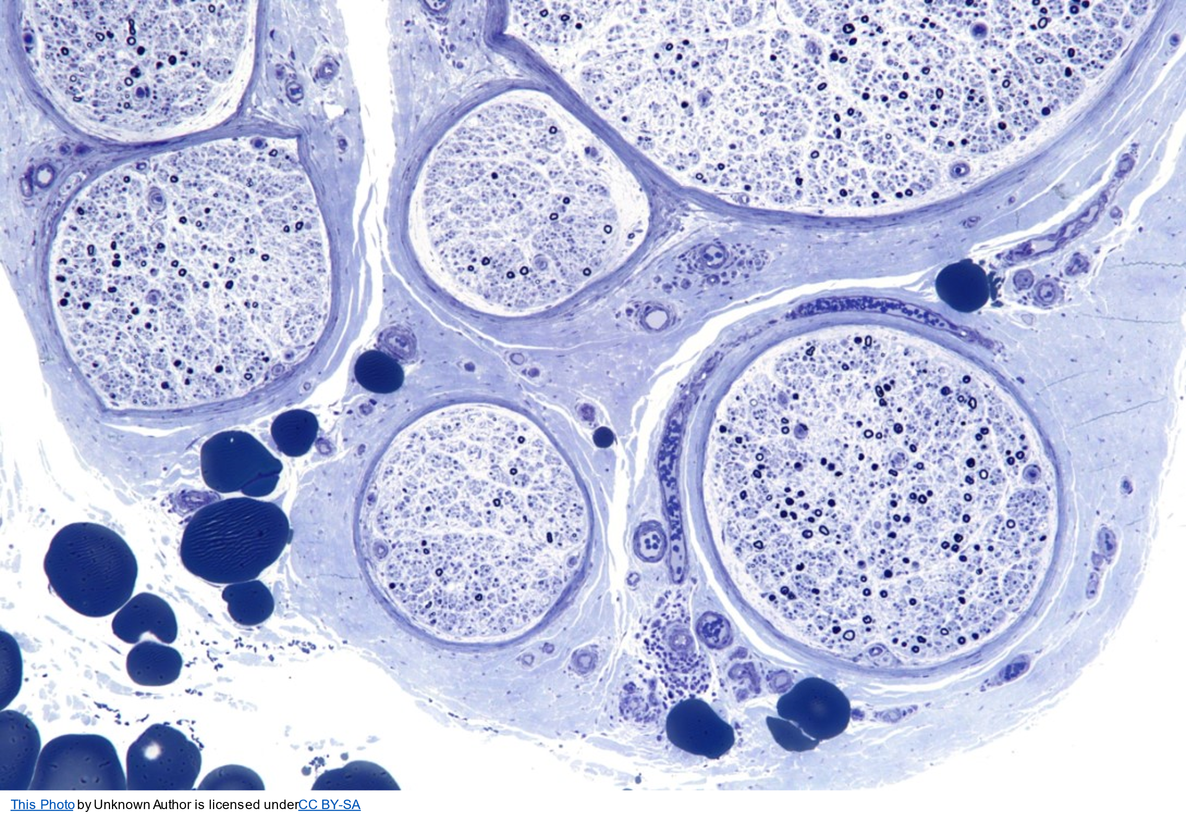
PERIPHERAL NEUROPATHY EVAluation
Michelle Mauermann MD
Professor of Neurology
Chair of the Division of Neuromuscular Medicine
Mayo Clinic, Rochester MN
IWMF Patient Support
October 12, 2022
Image copyright Shutterstock
©2022 Mayo Foundation for Medical Education and Research | slide-1

Slide 2
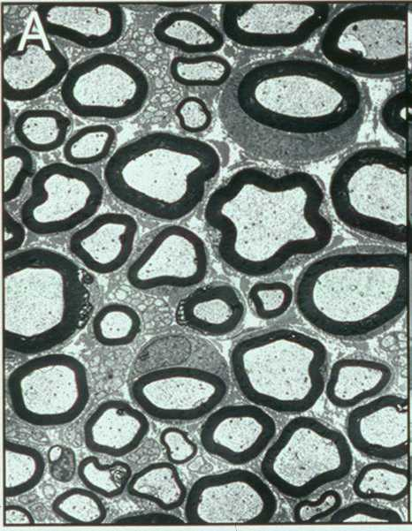
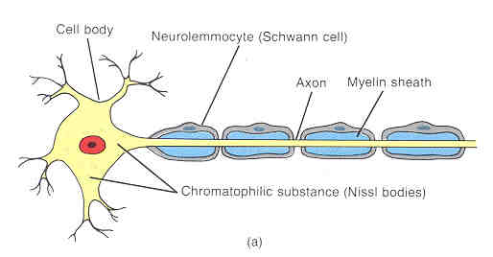
Peripheral Neuropathy
Peripheral Neuropathy
Large myelinated fiber: Motor; sensory: position, touch
Small myelinated fiber: Pain, temperature
Unmyelinated fiber: Pain and autonomic function
Notes:
Peripheral neuropathy - disease or dysfunction of peripheral nerves

Slide 3

Algorithm for approach to PN

Slide 4
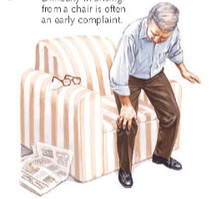
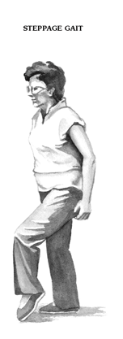
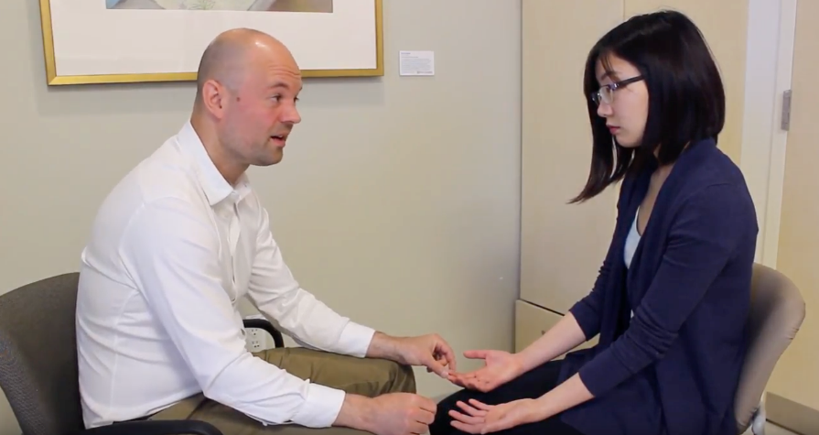
WHAT? – WHICH NERVE FIBERS
Sensory
  “Positive” - prickling, tingling, sharp, shock-like, contact sensitivity, burning, freezing
  “Negative” – dead-numbness, “coating”, imbalance
Motor
  Foot slapping, decreased dexterity of the fingers, trouble rising from a chair or lifting objects
Autonomic
  Postural lightheadedness
  Dry eyes and/or mouth
  Postprandial bloating, early satiety
  Constipation or diarrhea
  Urinary complaints
  Abnormal or absent sweating
  Erectile dysfunction

Slide 5
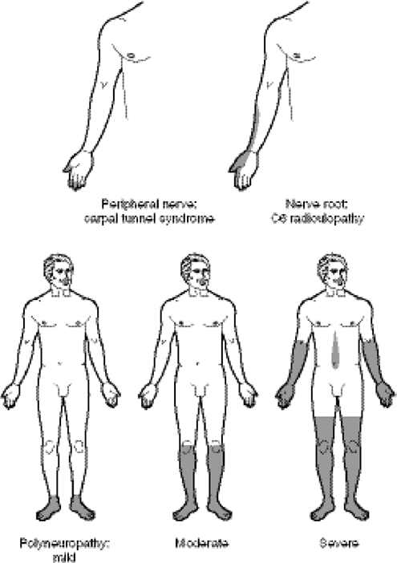
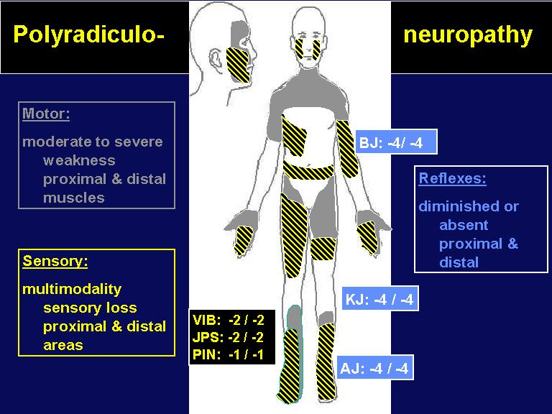
Where?
Distribution of nerve involvement
  Symmetric vs asymmetric
  Length-dependent or not

Slide 6
WHEn?
Temporal evolution
  Definite date of onset – yes or no
  Tempo
    Slow, insidious
    Rapid progression
    Relapsing

Slide 7
WHY?
Do you have other diagnoses associated with neuropathy?
  Waldenström diagnosis – treated or not, how? Cryoglobulins? Hyperviscosity? Associated amyloidosis?
  Diabetes, chronic kidney disease, HIV
  Rheumatologic conditions (autoimmune)
  Bariatric surgery and diet
  Other systemic symptoms – rash, joint pain, weight loss, enlarged tongue, LE edema
  Family history of neuropathy
  Medication review – chemotherapy/immunotherapy drugs

Slide 8
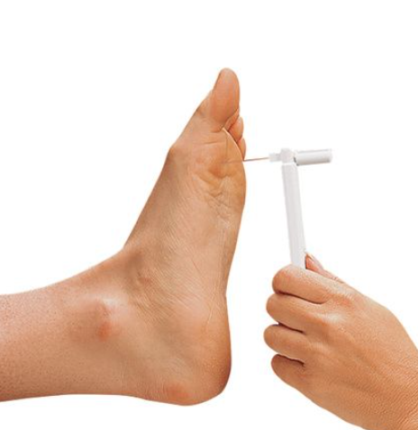
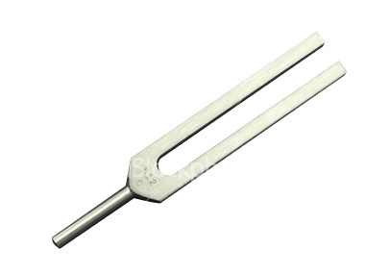
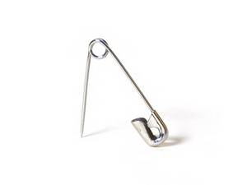
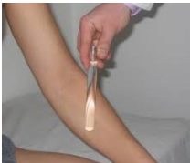
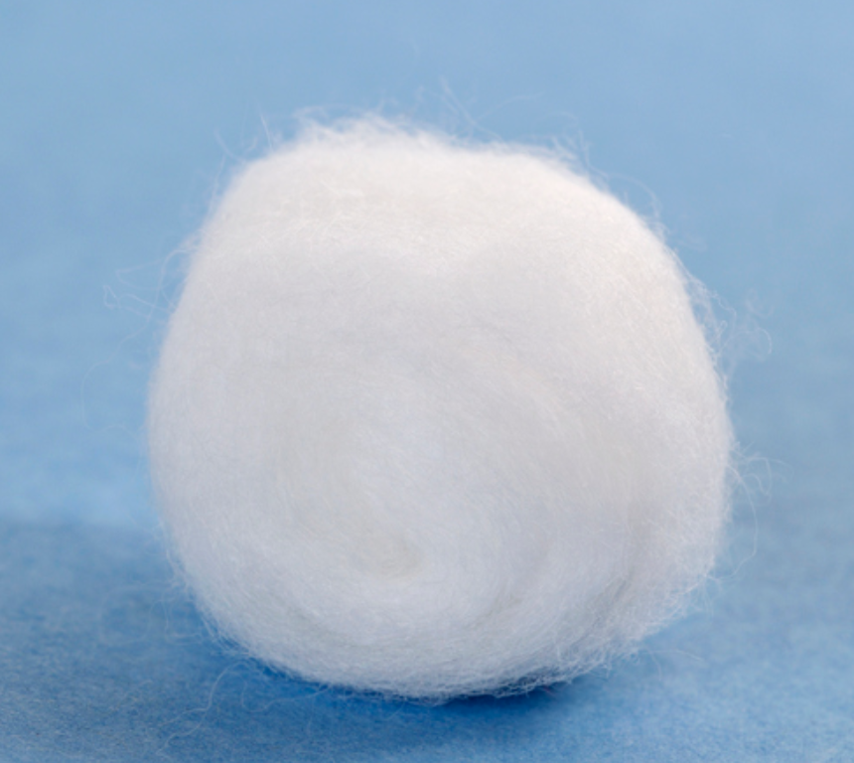
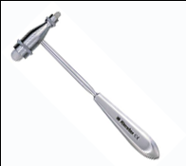
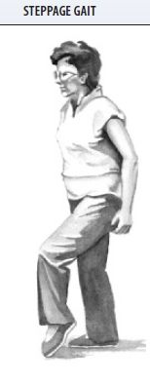
The Examination
Test sensation – touch, vibration, joint position, pain, temperature
Test strength – manual muscle examination
Test reflexes
Evaluate gait (walking)

Slide 9
PUT IT TOGETHER
Analyze the pattern and fiber type involved
  Length-dependent, symmetric, motor, sensory, autonomic
Chronic or acute and progression
Most common peripheral neuropathy presentation is a chronic, length-dependent sensory > motor neuropathy

Slide 10
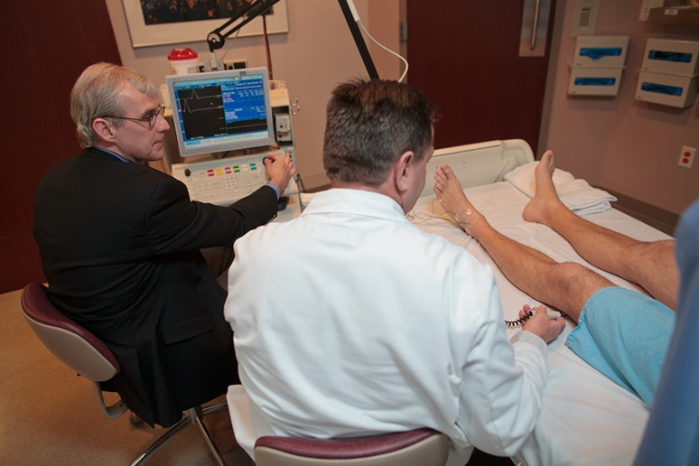
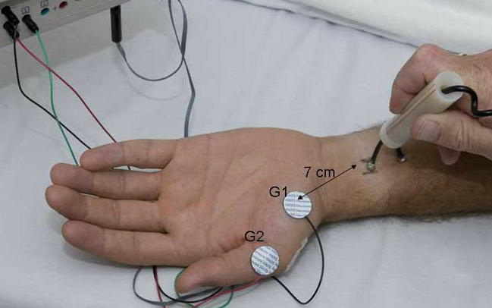
TYPICAL testing
Blood studies – MAG antibodies, Monoclonal protein assessments, excluding other causes (HgA1c, TSH, B12)
EMG – electromyography
  Confirm neuropathy – exclude low back or other mimickers
  Sensory and/or motor involvement
  Symmetry and pattern (Length-dependent)
  Axonal or demyelinating

Slide 11
Specialized testing
Consider specialized testing with certain types of peripheral neuropathy or diagnostic concerns
  What – if there are autonomic symptoms
  Where – atypical distribution of deficits – focal/multifocal or proximal/distal, pure motor or pure widespread sensory
  When - temporal profile-acute/subacute onset
  Why – systemic symptoms to suggest multiorgan/system disease, prior history or risk of malignancy

Slide 12
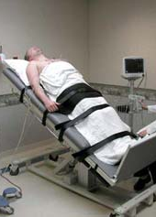
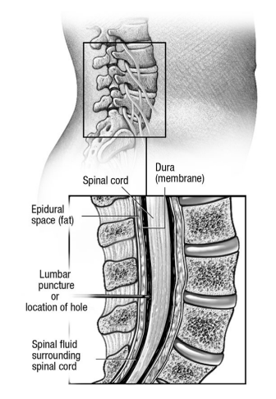
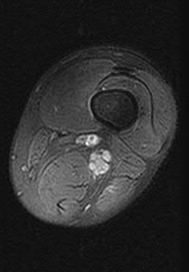
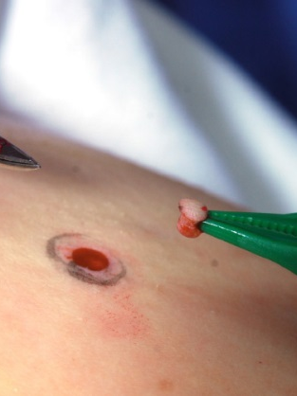
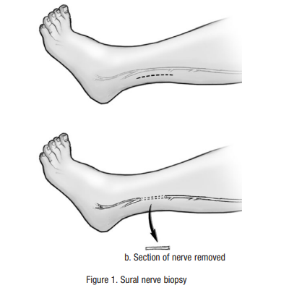
Specialized testing
Autonomic testing
Sweating, HR/BP control
Lumbar puncture
Inflammatory, Cancer cells
Imaging (US&MR)
Inflammatory, Malignancy
Skin Biopsy
Small fiber neuropathy, Amyloid
Nerve biopsy
Inflammation, Vasculitis, Amyloid, Lymphoma

Slide 13
Peripheral Neuropathy in Waldenströms Macroglobulinemia
Incidence of PN is ̴ 40%
Many types of neuropathy
Length-dependent sensory predominant neuropathy with imbalance (DADS)
Proximal and distal sensorimotor neuropathy (polyradiculoneuropathy)
Painful, acute, motor and sensory mononeuropathies (foot drop, wrist drop) – mononeuritis multiplex – vasculitis/cryoglobulins
Progressive sensory followed by motor length-dependent neuropathy, pain and autonomic – amyloid
Progressive painful sensorimotor peripheral neuropathy, mononeuropathy or polyradiculoneuropathy with systemic symptoms (weight loss, fatigue) +/- facial – lymphoma infiltration
Painful distal sensory neuropathy – chemotherapy (bortezomib, vincristine, platinum, taxol)

Slide 14
General recommendations
Any small injury to the skin can result in a serious infection and/or sores
Report any injuries to your feet to your health care provider right away
To avoid injuries:
  Do not cut or file corns, callouses
  Do not use chemicals on the feet
  Wear shoes or sturdy slippers at all times
  Do not apply direct heat to your feet and legs

Slide 15
General recommendations
Inspect your feet daily
  Look for injuries – blisters, cuts, bruises
  Itching, cracking, peeling
  Redness, red streaks, warmth, swelling, pain or drainage
  Callous formation
  Any change in the shape of your foot
Wash your feet daily with lukewarm water
Test the temperature with your hands
Use a mild fragrance-free soap and wash gently
Dry by blotting or patting
Dry between the toes
Apply a skin moisturizer without alcohol or perfume

Slide 16
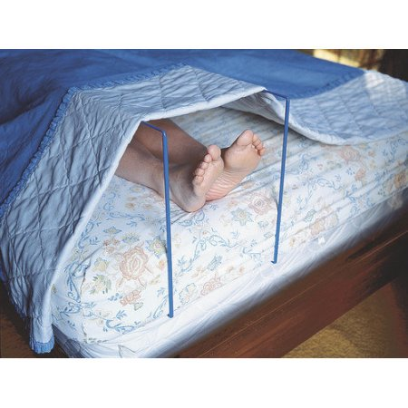
General recommendations
Care for nails – cut nails straight across, being careful not to injure surrounding skin
Do not go barefoot
Wear clean seamless socks
Wear shoes or sturdy slippers at all times even at night
Look inside shoes before putting them on
Choose good footwear – closed toe, lightweight, low heels, laces or straps
Keep the bed sheets off feet if you have sensitivity to touch
Balance and safety evaluation
Fall prevention plan
Exercise

Slide 17
THANK YOU

